Slide 1
CS 590 Algorithm
Chapter 10 The Greedy Method
Source: Goodrich, M. T., & Tamassia, R. (2015). Algorithm Design and Applications. Hoboken, NJ: Wiley.

Slide 2
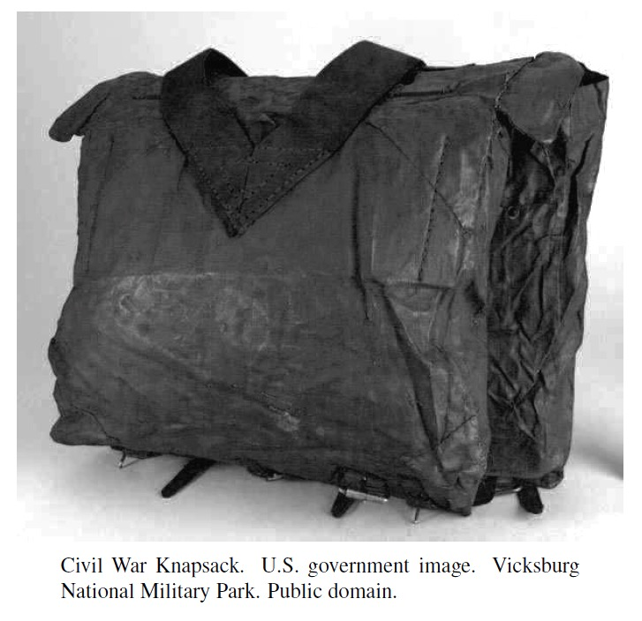
The Greedy Method
Presentation for use with the textbook, Algorithm Design and Applications, by M. T. Goodrich and R. Tamassia, Wiley, 2015

Slide 3
Application: Web Auctions
Suppose you are designing a new online auction website that is intended to process bids for multi-lot auctions.
This website should be able to handle a single auction for 100 units of the same digital camera or 500 units of the same smartphone, where bids are of the form, “x units for $y,” meaning that the bidder wants a quantity of x of the items being sold and is willing to pay $y for all x of them.
The challenge for your website is that it must allow for a large number of bidders to place such multi-lot bids and it must decide which bidders to choose as the winners.
Naturally, one is interested in designing the website so that it always chooses a set of winning bids that maximizes the total amount of money paid for the items being auctioned.
So how do you decide which bidders to choose as the winners?

Slide 4
The Greedy Method
The greedy method is a general algorithm design paradigm, built on the following elements:
configurations: different choices, collections, or values to find
objective function: a score assigned to configurations, which we want to either maximize or minimize
It works best when applied to problems with the greedy-choice property:
a globally-optimal solution can always be found by a series of local improvements from a starting configuration.

Slide 5
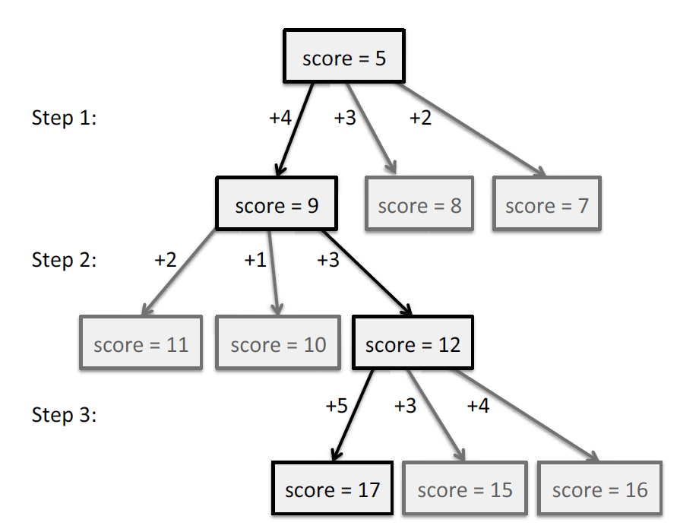
The Greedy Method
The sequence of choices starts from some well-understood starting configuration, and then iteratively makes the decision that is best from all of those that are currently possible, in terms of improving the objective function.

Slide 6
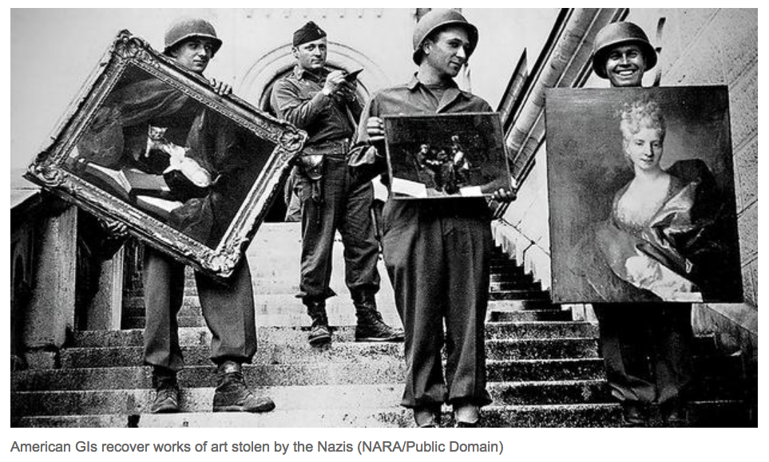
Web Auction Application
This greedy strategy works for the profit-maximizing online auction problem if you can satisfy a bid to buy x units for $y by selling k < x units for $yk/x.
In this case, this problem is equivalent to the fractional knapsack problem.

Slide 7
Web Auctions and the Fractional Knapsack Problem
In the knapsack problem, we are given a set of n items, each having a weight and a benefit, and we are interested in choosing the set of items that maximize our total benefit while not going over the weight capacity of the knapsack.
In the web auction application, each bid is an item, with its “weight” being the number of units being requested and its benefit being the amount of money being offered.
In the instance, where bids can be satisfied with a partial fulfillment, then it is an instance of the fractional knapsack problem, for which the greedy method works to find an optimal solution.
Interestingly, for the “0-1” version of the problem, where fractional choices are not allowed, then the greedy method may not work and the problem is potentially very difficult to solve in polynomial time.

Slide 8
The Fractional Knapsack Problem
Given: A set S of n items, with each item i having
b_{i} - a positive benefit
w_{i} - a positive weight
Goal: Choose items with maximum total benefit but with weight at most W.
If we are allowed to take fractional amounts, then this is the fractional knapsack problem.
In this case, we let x_{i} denote the amount we take of item i
Objective: maximize
Constraint:

Slide 9
Example
Given: A set S of n items, with each item i having
b_{i} - a positive benefit
w_{i} - a positive weight
Goal: Choose items with maximum total benefit but with weight at most W.
“knapsack”
Solution:
1 ml of 5
2 ml of 3
6 ml of 4
1 ml of 2
Items:
1
2
3
4
5
Weight:
4 ml
8 ml
2 ml
6 ml
1 ml
Benefit:
$12
$32
$40
$30
$50
10 ml
Value:
3
4
20
5
50
($ per ml)

Slide 10
The Fractional Knapsack Algorithm
Greedy choice: Keep taking item with highest value (benefit to weight ratio)
Since
Run time: O(n log n). Why?
Theorem 10.1 establishes correctness of Algorithm and running time: Next slide
Algorithm fractionalKnapsack(S, W)
Input: set S of items w/ benefit b_{i} and weight w_{i}; max. weight W Output: amount x_{i} of each item i to maximize benefit w/ weight at most W
for each item i in S
x_{i} ← 0
v_{i} ← b_{i} / w_{i} {value}
w ← 0 {total weight}
while w < W
remove item i w/ highest v_{i}
x_{i} ← min{w_{i} , W - w}
w ← w + min{w_{i} , W - w}

Slide 11
Analysis of Greedy Algorithm for Fractional Knapsack Problem
We can sort the items by their benefit-to-weight values, and then process them in this order.
This would require O(n log n) time to sort the items and then O(n) time to process them in the while-loop.
To see that our algorithm is correct, suppose, for the sake of contradiction, that there is an optimal solution better than the one chosen by this greedy algorithm.
Then there must be two items i and j such that
x_{i} < w_{i}, x_{j} > 0, and v_{i} > v_{j} .
Let y = min{w_{i} − x_{i}, x_{j}}.
But then we could replace an amount y of item j with an equal amount of item i, thus increasing the total benefit without changing the total weight, which contradicts the assumption that this non-greedy solution is optimal.

Slide 12
Task Scheduling
Given: a set T of n tasks, each having:
A start time, s_{i}
A finish time, f_{i} (where s_{i} < f_{i})
Goal: Perform all the tasks using a minimum number of “machines.”
Machine 3
Machine 2
Machine 1
1
2
3
4
5
6
7
8
9

Slide 13
Example
Given: a set T of n tasks, each having:
A start time, s_{i}
A finish time, f_{i} (where s_{i} < f_{i})
[1,4], [1,3], [2,5], [3,7], [4,7], [6,9], [7,8] (ordered by start)
Goal: Perform all tasks on min. number of machines
Machine 3
Machine 2
Machine 1
1
2
3
4
5
6
7
8
9

Slide 14
Task Scheduling Algorithm
Greedy choice: consider tasks by their start time and use as few machines as possible with this order.
Run time: O(n log n). Why?
Correctness: Suppose there is a better schedule.
We can use k-1 machines
The algorithm uses k
Let i be first task scheduled on machine k
Machine i must conflict with k-1 other tasks
But that means there is no non-conflicting schedule using k-1 machines
Algorithm taskSchedule(T)
Input: set T of tasks w/ start time s_{i} and finish time f_{i}
Output: non-conflicting schedule with minimum number of machines
m ← 0 {no. of machines}
while T is not empty
remove task i w/ smallest s_{i}
if there’s a machine j for i then
schedule i on machine j
else
m ← m + 1
schedule i on machine m

Slide 15
Text Compression
Given a string X, efficiently encode X into a smaller string Y
Saves memory and/or bandwidth
A good approach: Huffman encoding
Compute frequency f(c) for each character c.
Encode high-frequency characters with short code words
No code word is a prefix for another code
Use an optimal encoding tree to determine the code words

Slide 16
Encoding Tree Example
A code is a mapping of each character of an alphabet to a binary code-word
A prefix code is a binary code such that no code-word is the prefix of another code-word
An encoding tree represents a prefix code
Each external node stores a character
The code word of a character is given by the path from the root to the external node storing the character (0 for a left child and 1 for a right child)
00 | 010 | 011 | 10 | 11
a | b | c | d | e
a
d
e
b
c

Slide 17
Encoding Tree Optimization
Given a text string X, we want to find a prefix code for the characters of X that yields a small encoding for X
Frequent characters should have short code-words
Rare characters should have longer code-words
Example
X = abracadabra
T₁ encodes X into 29 bits
T₂ encodes X into 24 bits
T₁
T₂
c
d
b
a
b
r
a
r
c
d

Slide 18
Huffman’s Algorithm
Given a string X, Huffman’s algorithm construct a prefix code the minimizes the size of the encoding of X
A heap-based priority queue is used as an auxiliary structure.
Using the frequency of each character in C as the weight of its associated external node, the problem of constructing an optimal prefix code can be reduced to the problem of constructing a binary tree with minimum total path weight.
It runs in time O(n + d log d), where n is the size of X and d is the number of distinct characters of X

Slide 19
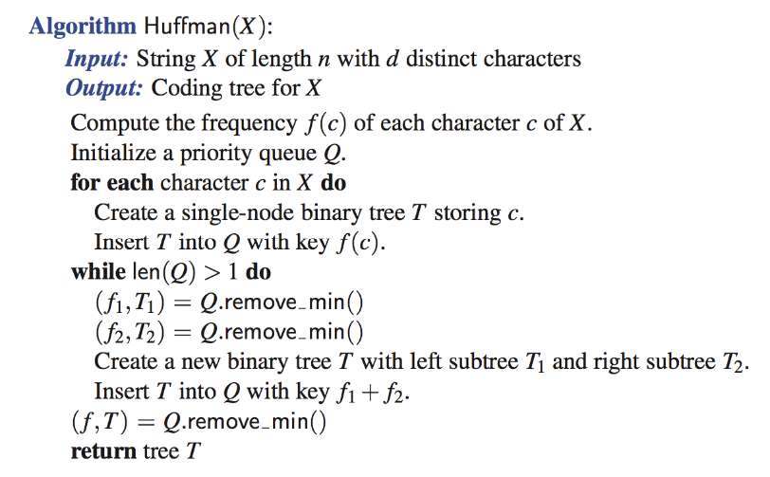
Huffman’s Algorithm

Slide 20
Example
11
X = abracadabra
a
6
Frequencies
2
4
a | b | c | d | r
5 | 2 | 1 | 1 | 2
c
d
b
r
6
2
4
a
b
c
d
r
5
2
1
1
2
a
c
d
b
r
5
2
2
4
a
b
c
d
r
a
c
d
b
r
5
2
2
5

Slide 21
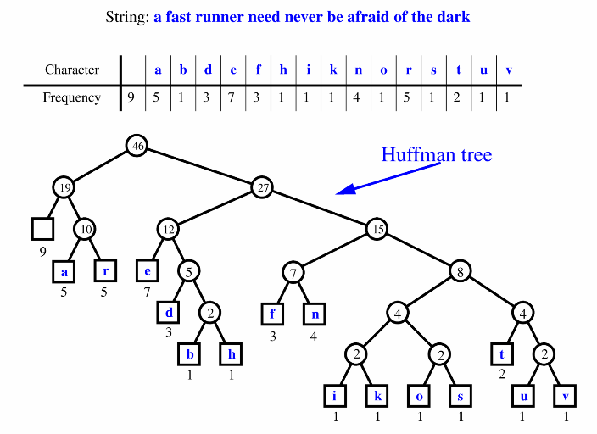
Extended Huffman Tree Example

Slide 22
About Stevens
A premier, private research university with a mission to inspire, nurture and educate leaders in tomorrow’s technology-centric environment while contributing to the solution of the most challenging problems of our time

